Slide 1
Carpooling for the Green Initiative
Chase Cupp, Chris Hewitt, Doug Murphy, Emanuel Smith
6/26/14

Slide 2
Agenda
Objective - Chris
Requirements - Chris
Limitations - Chris
Functional/GUI Design – Emanuel
UML Class Diagrams - Doug
Database - Doug
Pseudo Code - Chase
Testing - Chris
Q&A – All

Slide 3
Objective
Design, Develop, and Deploy
Align with Green Initiative
Design Goals
User-Friendly
Simple Interface
Easy to Learn
Helpful Features

Slide 4
High-Level Requirements

Slide 5
High-Level Requirements
Log In Interface
Client Credentials
Member Profile
Populated Fields
Insert, Edit, Delete
View Members
“Join Carpool”
Automated Address Search
Requests to Join
Multiple Carpools

Slide 6
High-Level Requirements
“Create Carpool”
Carpool Leader
Requests
Schedule
Carpool Messaging Feature
SMS
Carpool Schedule
Reminder

Slide 7
High-Level Requirements
Carpool Calculator Tool
Carpool Route Functionality
Google Maps API & Apple Maps API
“Leaving Now” Notification Feature
Removes Uncertainty
Member Data
Hosted and Managed by CGI

Slide 8
Limitations
Dedicated Mobile Application
Requires Android or iOS device
$25,000 Budget
6 weeks – Total Project Time
3 weeks – Development
3 weeks – Testing

Slide 9
Functional/GUI Design

Slide 10
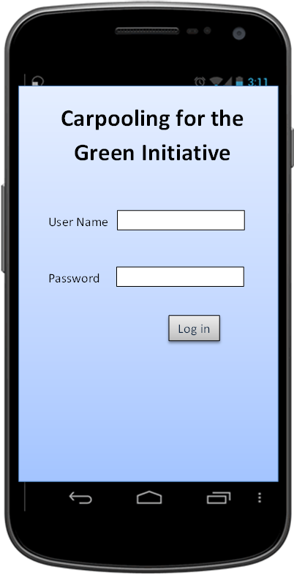
Login

Slide 11
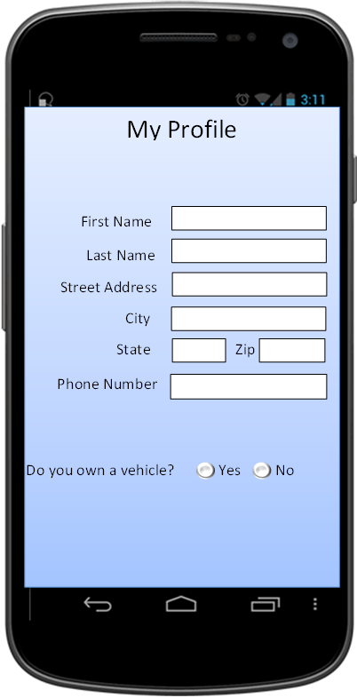
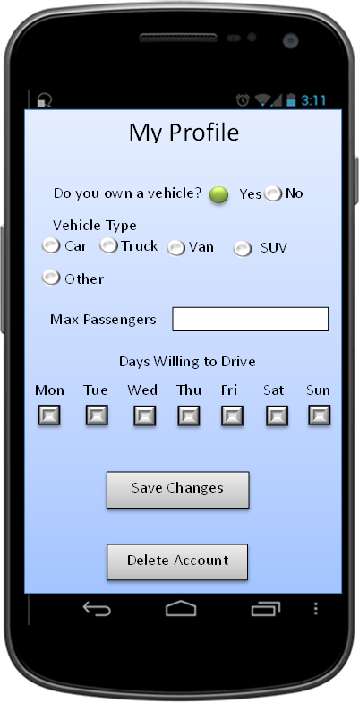
My Profile

Slide 12
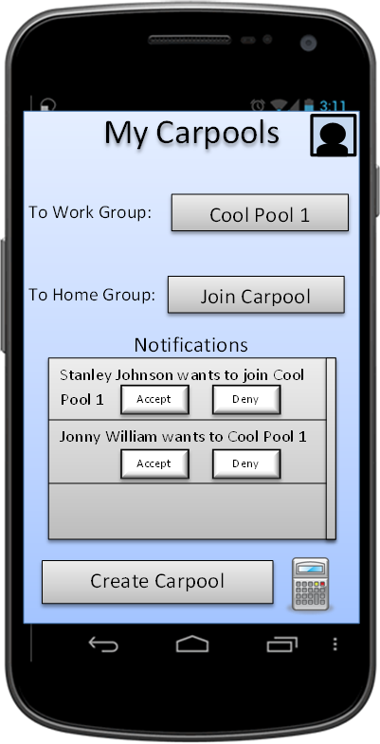
Home Page

Slide 13
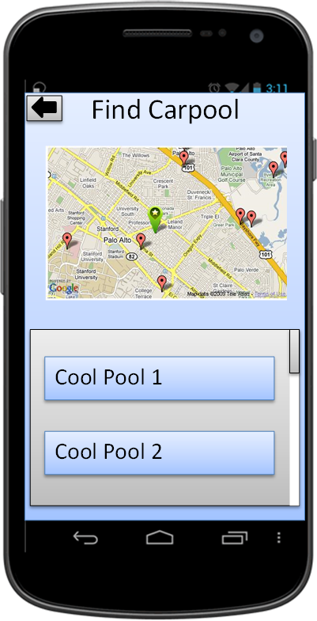
Find Carpool

Slide 14
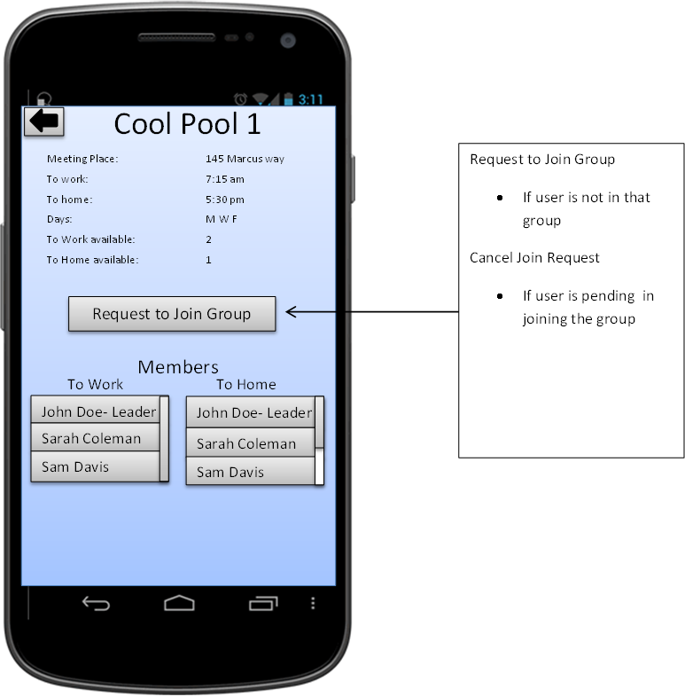
Carpool Information

Slide 15
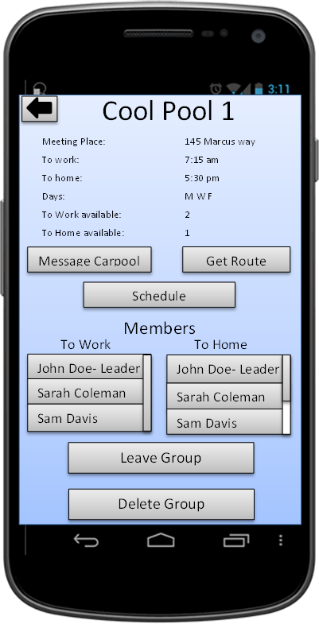
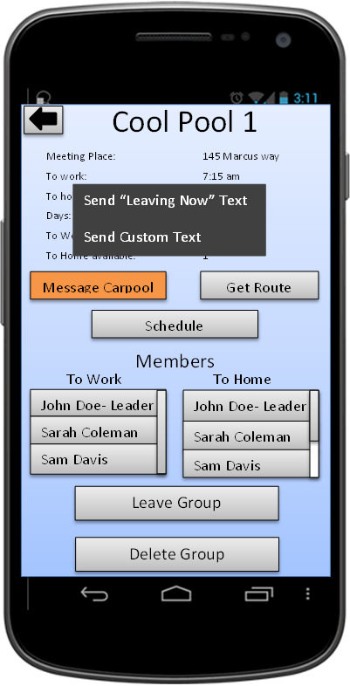
Carpool Information

Slide 16
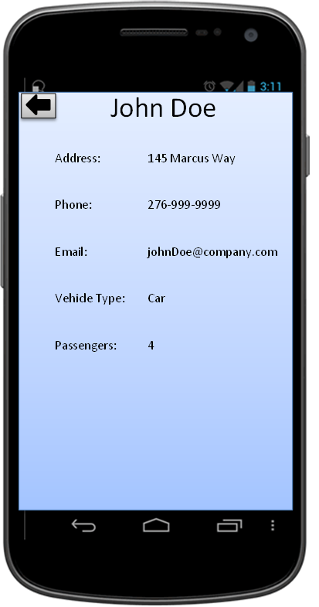
Member Information

Slide 17
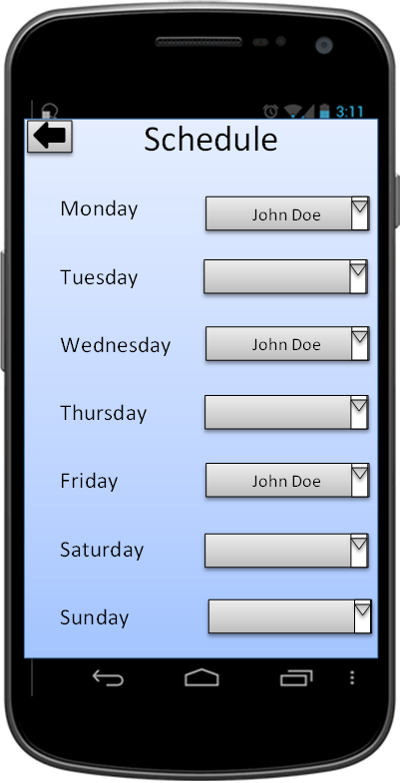
Driving Schedule

Slide 18
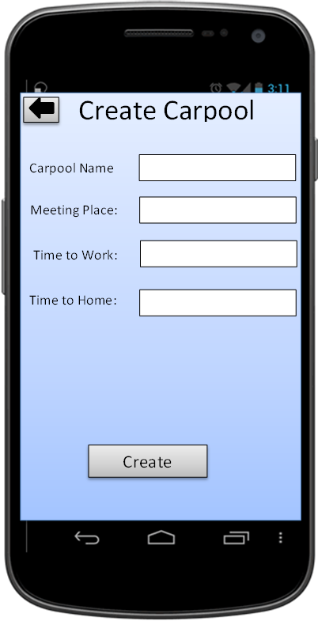
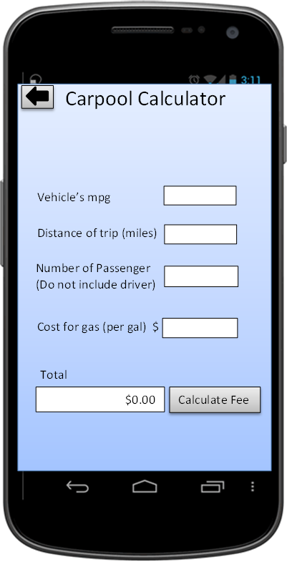
Create Carpool

Slide 19
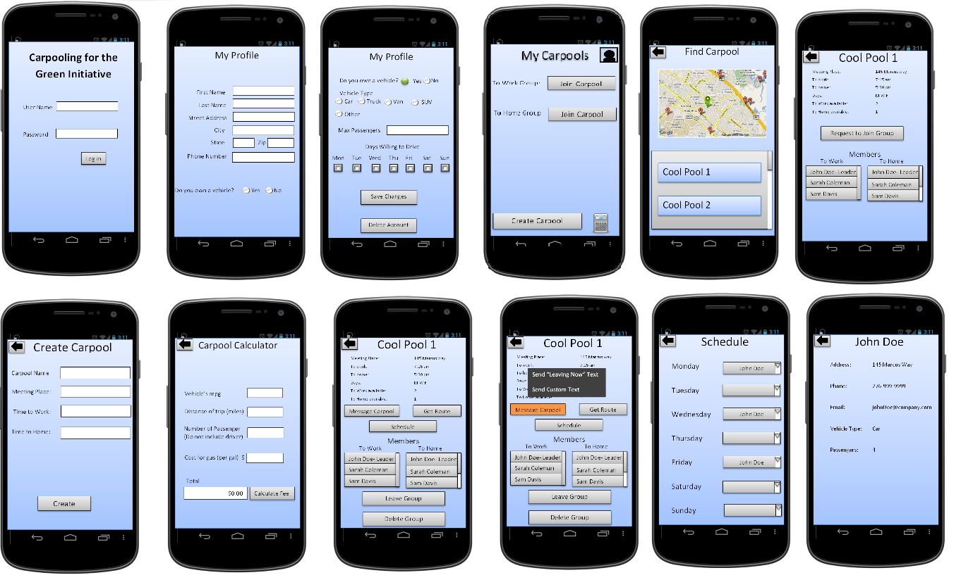
GUI Summary

Slide 20
UML Class Diagrams

Slide 21
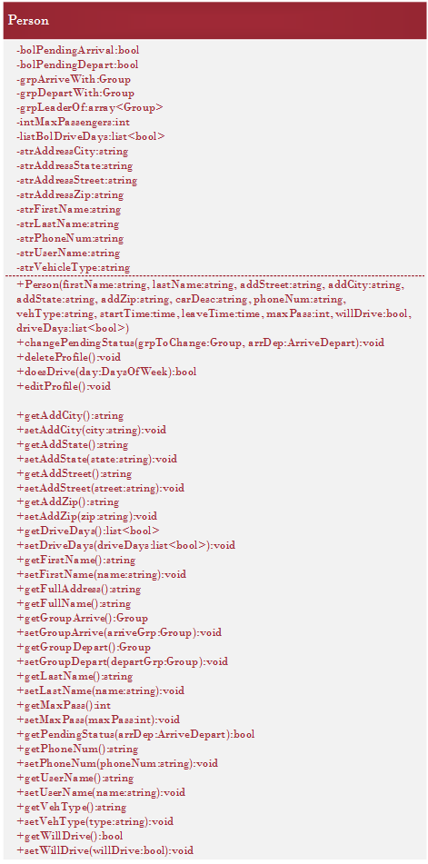
UML Class Diagram - Person

Slide 22
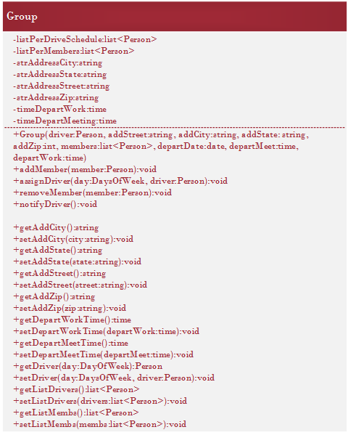
UML Class Diagram - Group

Slide 23
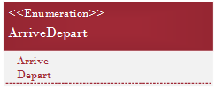
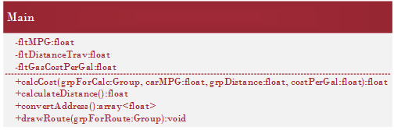
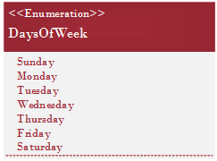
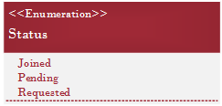
UML Class Diagram - Other

Slide 24
Database

Slide 25
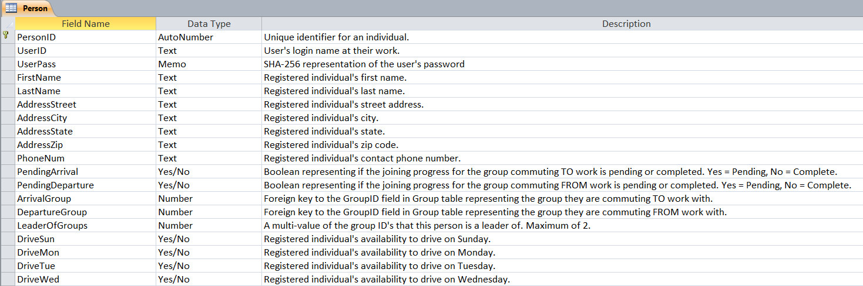
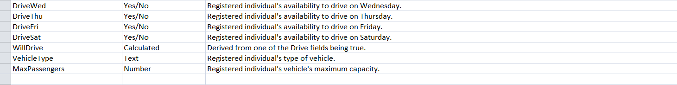
Database Schema - Person
Referential Integrity
Allow Null Values

Slide 26
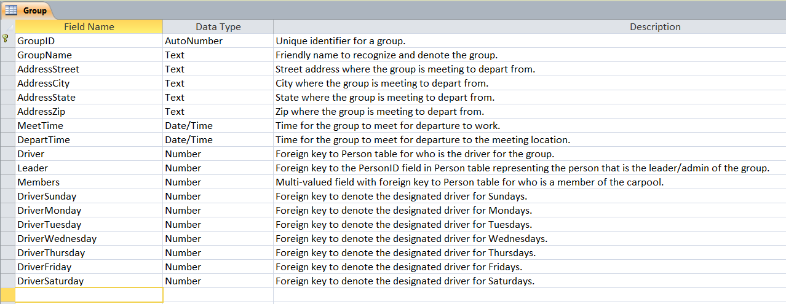
Database Schema - Group
Referential Integrity
Allow Null Values

Slide 27
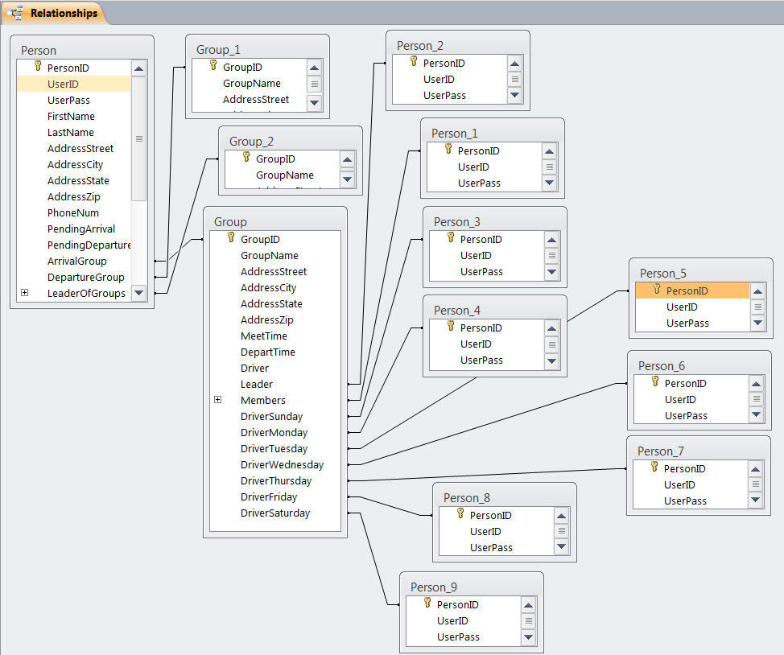
Database Schema - Relationships

Slide 28
Pseudo Code

Slide 29
Pseudo Code
Placeholder

Slide 30
Testing

Slide 31
Testing
Maximum 3 weeks of testing
Completed by August 8, 2014
2 working days for following phases:
Unit Testing
Integration Testing
Data Foundation Testing
System Testing
User Acceptance Testing
5 working days for Client Acceptance Testing

Slide 32
Testing
General Dependencies
Database integration complete before any testing
All phases completed on Android

Slide 33
Testing
Testing Phase Dependencies
Data Foundation bugs resolved prior to System Testing
Prior to UAT:
100% of critical bugs resolved
50% of medium and low bugs resolved

Slide 34
Testing
Production Promotion Dependencies
All critical bugs preventing implementation into production have been resolved
75% of medium and low priority bugs have been resolved.

Slide 35
Questions?

